Slide 1


micro:bit entry video tutorial
Lesson 12
micro:bit sensor lesson 12 “Animal World”
YahBoom micro:bit module tutorial

Slide 2
micro:bit entry video tutorial
Content
Part1
Part 2
Part3
Part 4
Part 5
Learning goals
Preparation
Connection
Search for blocks
Combine blocks
YahBoom micro:bit module tutorial

Slide 3
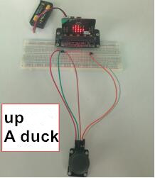
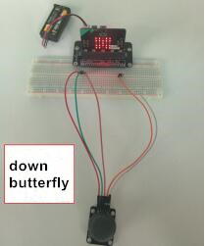
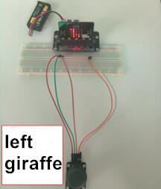
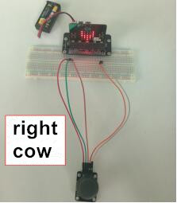
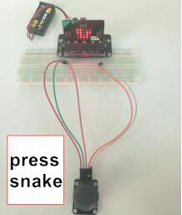
micro:bit entry video tutorial
Part 1
Learning goals
After you download the program, you can shake the rocker bar up and down, you can switch the pattern on the dot matrix, just like looking at the photo album, there are many small animals in the album. Going up we can see the ducklings. Turn down to see the butterfly. Turn left to see the giraffe. Turn to the right to see the cow. Press to see the snake.
YahBoom micro:bit模 module tutorial

Slide 4
micro:bit entry video tutorial
Part 2
Hardware:
● 1 X Micro: bit Board
● 1 X Micro:bit breakout
● 5 X Male to male cable
● 1 X Micro USB Cable
● 1 X Rocker module
● 1 X 830 holes breadboard
● 1 X PC
Preparation
Then the micro:bit is connected to the computer through USB, and the computer will pop up a U disk and click the URL in the U disk to enter the programming interface. Input this URL https://github.com/lzty634158/yahboom_mbit_en to get the package.
YahBoom micro:bit module tutorial

Slide 5
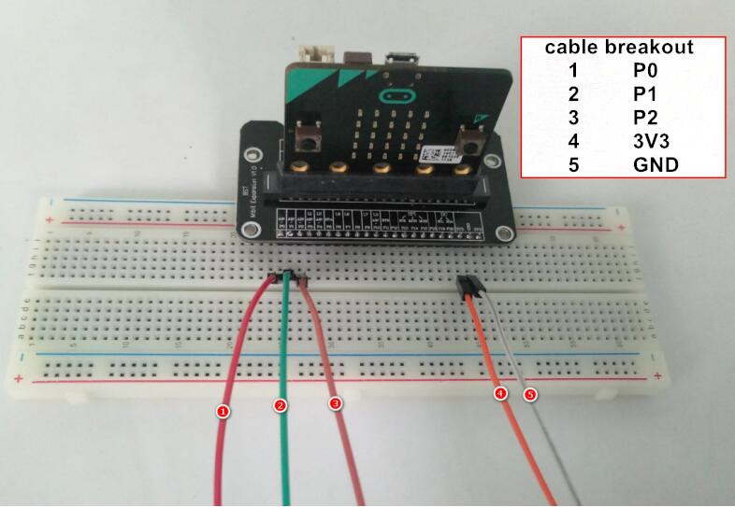
micro:bit entry video tutorial
Part 3
Connection
YahBoom micro:bit module tutorial

Slide 6
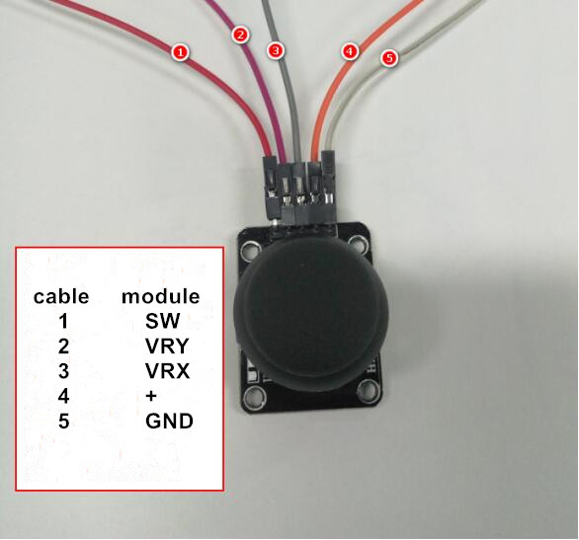
micro:bit entry video tutorial
Part 3
Connection
YahBoom micro:bit module tutorial

Slide 7
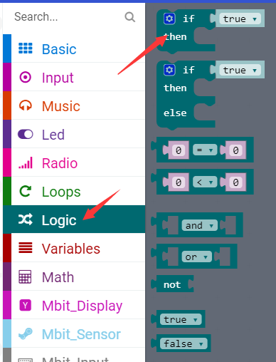
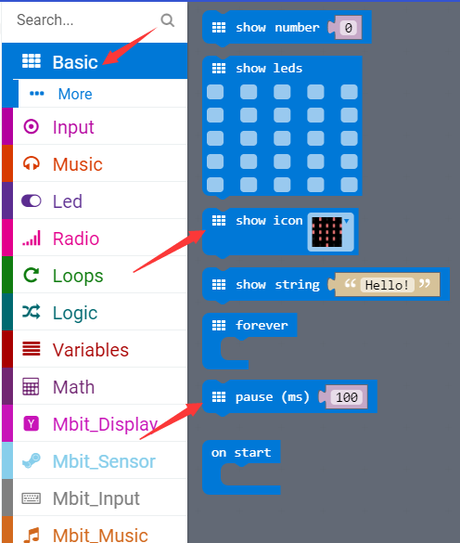
micro:bit entry video tutorial
Part 3
Search for blocks
YahBoom micro:bit module tutorial

Slide 8
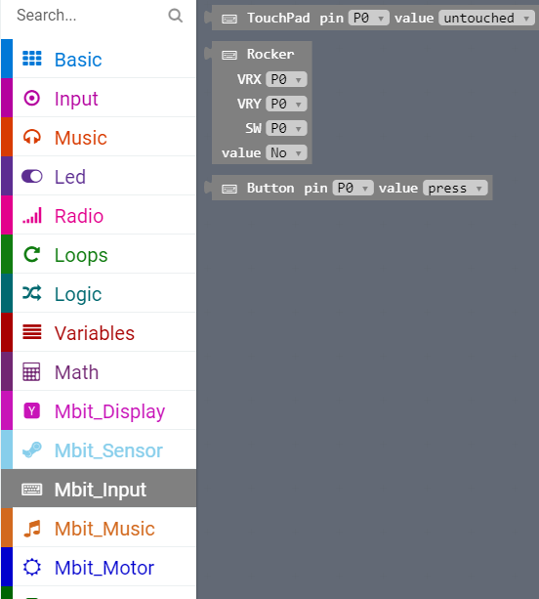
micro:bit entry video tutorial
Part 4
Search for blocks
YahBoom micro:bit module tutorial

Slide 9
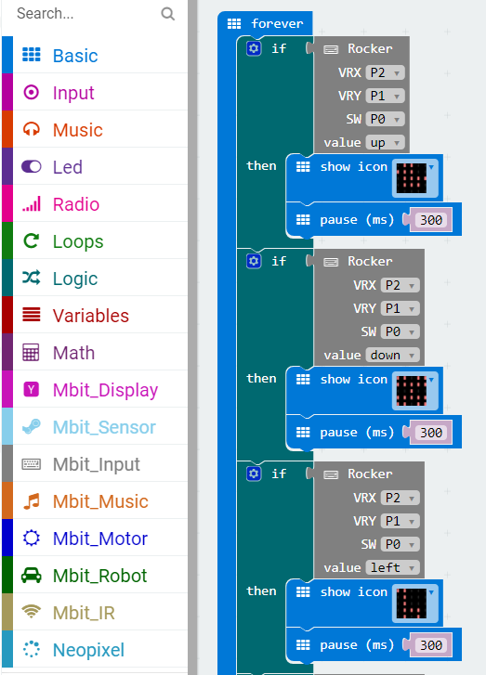
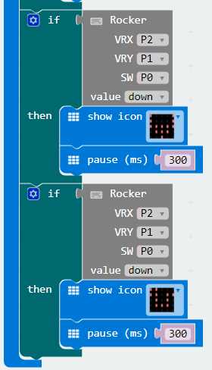
micro:bit entry video tutorial
Part 5
Combine blocks
YahBoom micro:bit module tutorial

Slide 10
micro:bit entry video tutorial
micro:bit
project
Thanks for watching！
Powered by YahBoom
YahBoom micro:bit module tutorial

